Slide 1
Technologies for Tomorrow
By : Team Aurora

Slide 2
“Anyone who stops learning is old, whatever at twenty or eighty.”
-Henry Ford

Slide 3
Problem Statement
An innovative way of learning for students in early stage to make them conceptually strong for their further education.

Slide 4
Problem Faced Today
Students are not conceptually strong at early age. All the students are taught about cramming and mugging up.
Students don’t feel learning as a fun activity.
Signature for a blind person is a difficult task.
Help for dumb and deaf people to convey their thoughts.

Slide 5
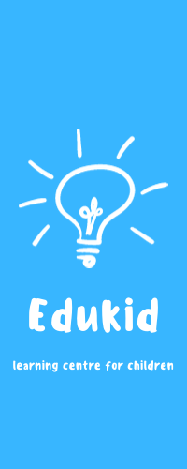
EduKid

Slide 6
Project objective
To help early stage students in their learning process.
To help blind people to write their emotions using gesture.
To help dumb and deaf people to convey their thoughts.

Slide 7

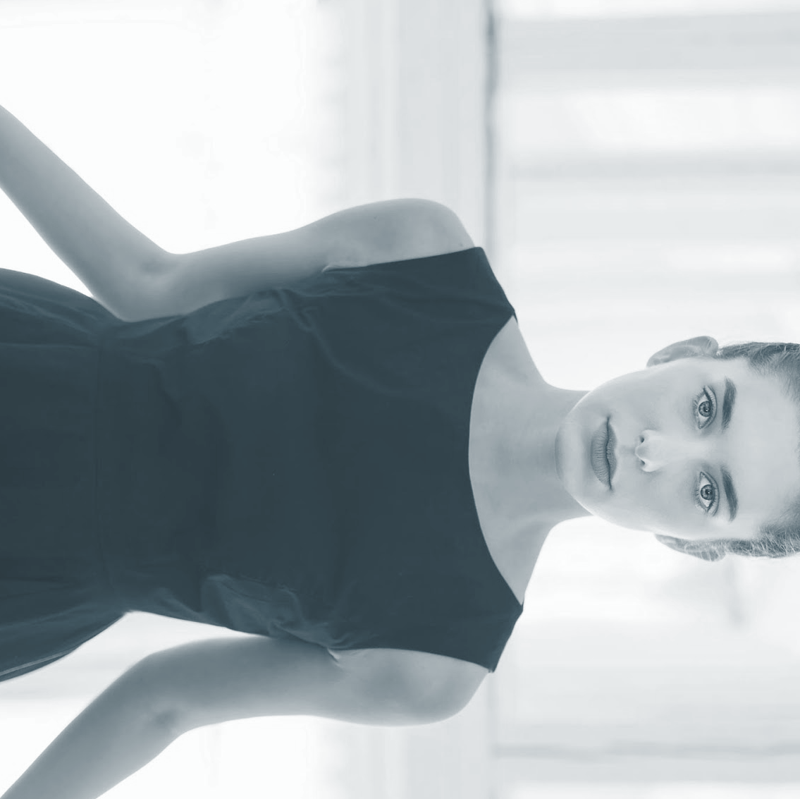
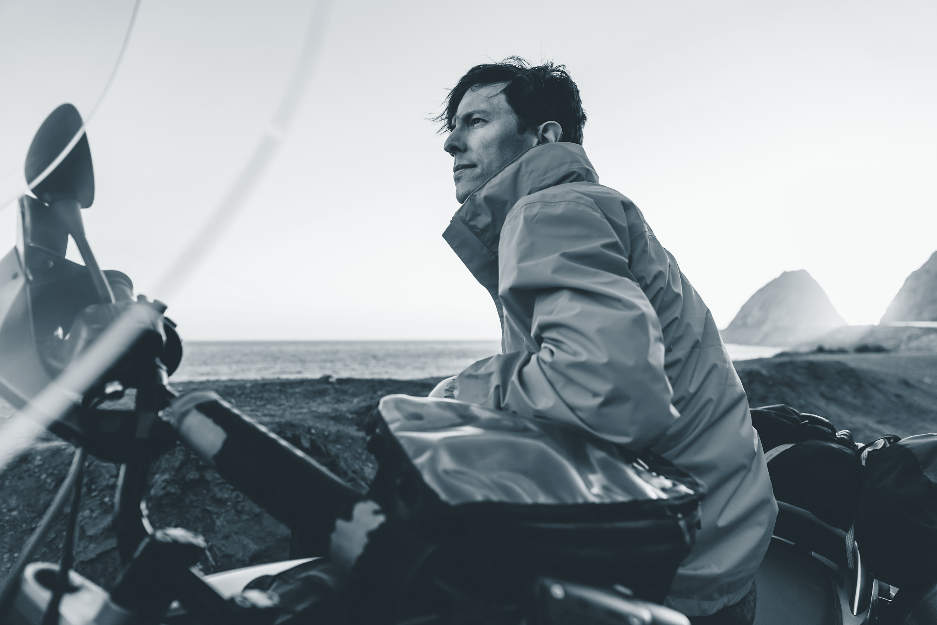
Target audience
Early age students of age group (3-15 years old).
Teachers for effective presentation.
Blind people to overcome their signature problem.
Dumb and .deaf people.

Slide 8
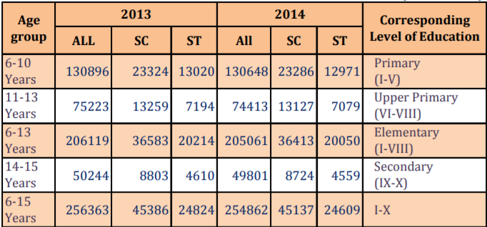
Literacy rate Trend
Following table shows the change of literacy rate from year 2013 to year 2014

Slide 9
Technology Used
We are going to use machine learning for the gesture recognition, which will recognize gestures of the user and predict the outcomes based on the learning. This includes digits, alphabets and hindi characters (devnagri).
Language used:
Python and its libraries like(numby, tensorflow, matplotlib, keras, openCV etc.)
Java
Text editor:
Sublime text
Android studio

Slide 10
Functionality and Working
This project will provide an interface which will access webcam of laptop or front camera of mobile phones and will recognise the gestures and do the further tasks.
The tasks may include recognition of alphabets, digits and hindi characters.

Slide 11
Platforms
Available for android.
It will be available for web application and ios application further.

Slide 12
Future Scope
We can add different emojis to enhance the confidence of the students.
This system can be made multilingual for students living in different regions.
This project can be stretched to recognise the sign language used by the dumb and deaf peoples to interact or convey their message.
Blind people can do the challenging stuffs like signature with ease.

Slide 13
Outcomes
The outcomes may include the fun way of learning stuff for kids and early age students.
Building of conceptually strong students.
The independency of dumb and deaf people is maintained. They do not need any third person to convey their messages.
Authenticity of blind persons can be maintained in case of signature as a security purpose.

Slide 14
Thank You

